Slide 1

CASE STUDY DATABASE MANAGEMENT SYSTEM KOOKABURRA
KOOKABURRA

Slide 2
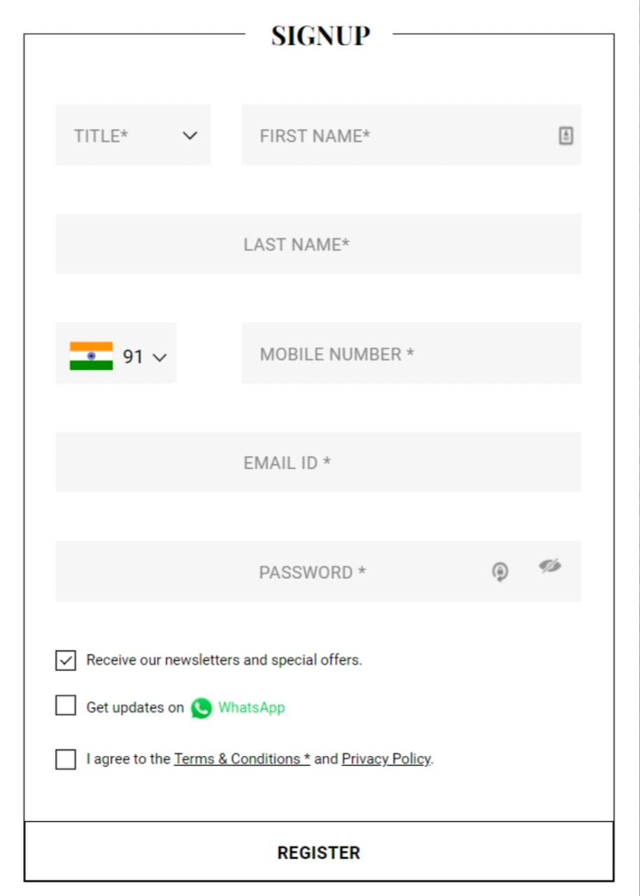
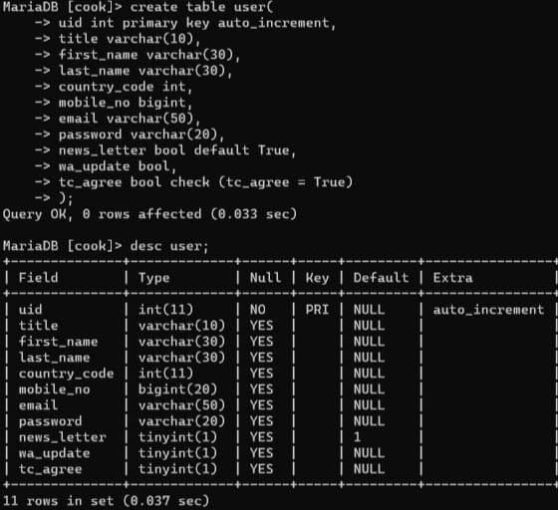
Query For Create User Table

Slide 3
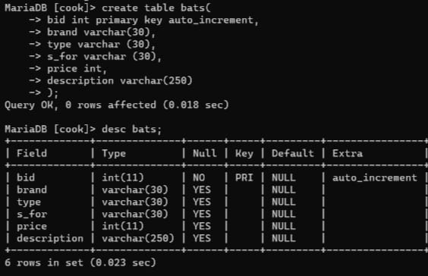
Create Bat Table

Slide 4
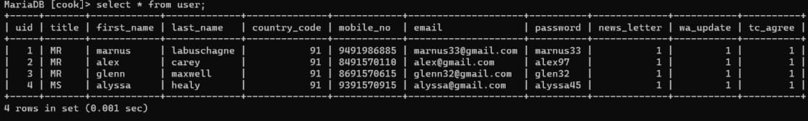
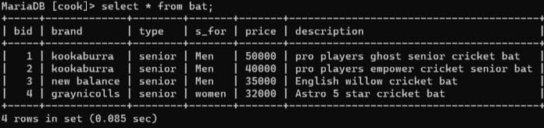
Show Bats And Users

Slide 5
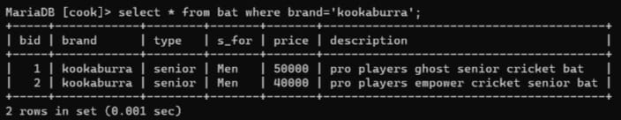
Show Bats By Brand:Kookaburra

Slide 6
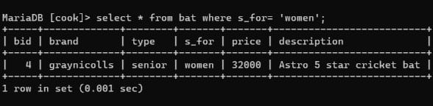
Show Bats for Women

Slide 7
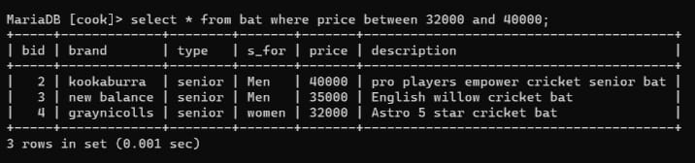
Show Bats In Price Range

Slide 8
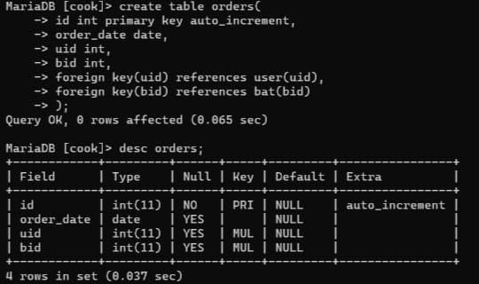
Create Orders Table

Slide 9
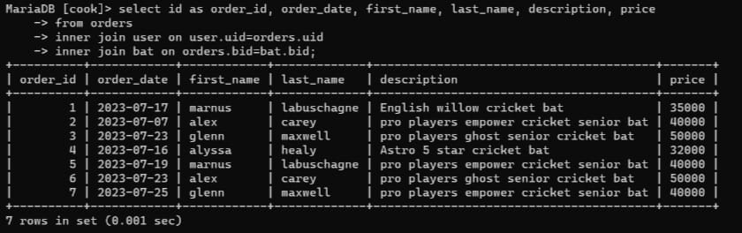
Show all orders with customer name and bats description

Slide 10
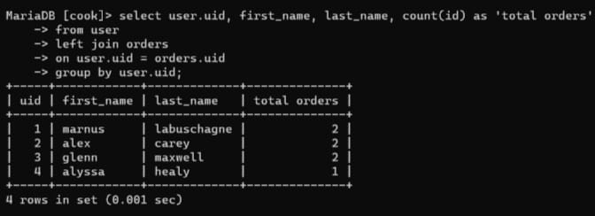
Show order count of every user

Slide 11
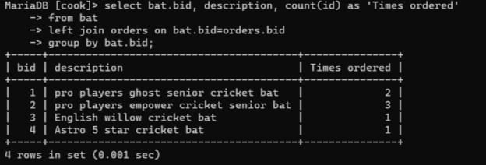
Show order count of every bat

